Slide 1
Quality Assurance for Manufacturing

Slide 2
Product quality has become key in manufacturing for good reason. COST.
The cost of fixing the problem at the end of the line is drastically higher than predicting the problem before it happens and correcting or scrapping the product at the early stages of production. Furthermore, the cost of a faulty, or subpar, product that reaches the customer affects customer loyalty and churn, warranty costs, as well as customer support overhead.
Quality Assurance for Manufacturing leverages existent test systems and historical failures data then combines them with domain knowledge and root cause analysis to predict production failures.
1.
4.
2.
5.
3.
6.

Slide 3
Why use Quality Assurance for Manufacturing?

Slide 4
Predict Costly Production Issues
Quality assurance across the assembly line is imperative. Identifying errors, slowdowns and predicting potential failures before they occur, rather than after they are detected, helps companies be proactive and improve productivity.

Slide 5
Quality Assurance for Manufacturing | Benefits
REDUCE
Costs and Downtime
INCREASE
Speed to Market
IMPROVE
Product Quality
INFORM
Possible Equipment Fault or Failure
DIMINISH
Scrap and Rework
BOOST
Customer Satisfaction
DELIVER
Real-time Analytics

Slide 6
Unlock the Potential of Existing Data
and Test Systems Already In Place

Slide 7
Customer Use Case

Slide 8



Minimize downtime with predictive capabilities
Challenge
Better predict errors or failures on assembly floor before they occur, saving customers’ time and money.
Strategy
Transformed its manufacturing production line with advanced analytics solutions like Azure IoT Suite and Cortana Intelligence Suite.
Results
Ability to predict machine processes that will slow down or fail with an 80% accuracy
Cost savings of scrap and re-work of 17%
Energy savings of 10%
“Since deploying the Microsoft predictive analytics solutions, we have seen at least an 80% accuracy rate in the prediction of machine processes that will slow down or fail, contributing to a scrap and rework savings of 17 percent.”
— Clint Belinsky, Vice President, Global Quality, Jabil
Notes:
Jabil
Customer profile: Florida-based Jabil is one of the world’s leading design and manufacturing solution providers.
Challenge: Jabil wanted to create a solution that would identify errors or failures early in the manufacturing process – before they even occurred.
Strategy: Working with Microsoft, Jabil’s developed a solution, which uses Microsoft Azure services, analyzing millions of data points from machines running dozens of steps through the manufacturing process, predicting failures earlier in the process.
Results: Jabil was able to predict failures early in the processes with an 80% accuracy contributing to a scrap and re-work savings of 17 percent, and an energy savings of 10 percent. These are considered significant improvements and Jabil is in the process of implementing these solutions in their factories in Malaysia and Mexico.
Additional information:
http://blogs.microsoft.com/transform/2016/04/24/how-manufacturers-are-creating-the-digital-intelligent-and-predictive-factory/#sm.0001q3qurpfqzdmzshm1ze5411zli
https://www.youtube.com/watch?time_continue=5&v=bGVRH1Lfqe8
<Click>

Slide 9
Demo
Notes:
Video:
URL: https://www.youtube.com/watch?v=bGVRH1Lfqe8
Additional information:
http://blogs.microsoft.com/transform/2016/04/24/how-manufacturers-are-creating-the-digital-intelligent-and-predictive-factory/#sm.0001q3qurpfqzdmzshm1ze5411zli

Slide 10
Inside Quality Assurance for Manufacturing

Slide 11
Quality Assurance for Manufacturing | Challenges
IDENTIFYING…
ACCESSING…
LEVERAGING…
INTERPRETING…
SCALING…
...the correct data to build reliable predictions
…real-time and historic data from all available sources
…domain knowledge and existent test systems
…data and analysis results to find actionable insights
…the solution to increasing requirements

Slide 12
Quality Assurance for Manufacturing | How to Start
DATA
Are there identifiers for predictions?
EXPERTISE
Are there examples of past failures?
GOALS
Has a use case been defined?
QUALITY
Is the data applicable and accurate?
QUANTITY
Is there enough data for an accurate prediction?

Slide 13
Quality Assurance for Manufacturing | Architecture
Azure Machine Learning
Compares test data, historic data and failure data to make real-time predictions.
Azure SQL Data Warehouse
Historic and real-time data is stored along with predictions.
Azure Event Hub
Azure Stream Analytics
This highly-scalable service ingests and distributes test data.
Sends test data to Machine Learning, Data Warehouse and PowerBI. Sends predictions to PowerBI and Data Warehouse.
Power BI
Creates reports and visualizations based on the real-time and historical data and predictions.

Slide 14
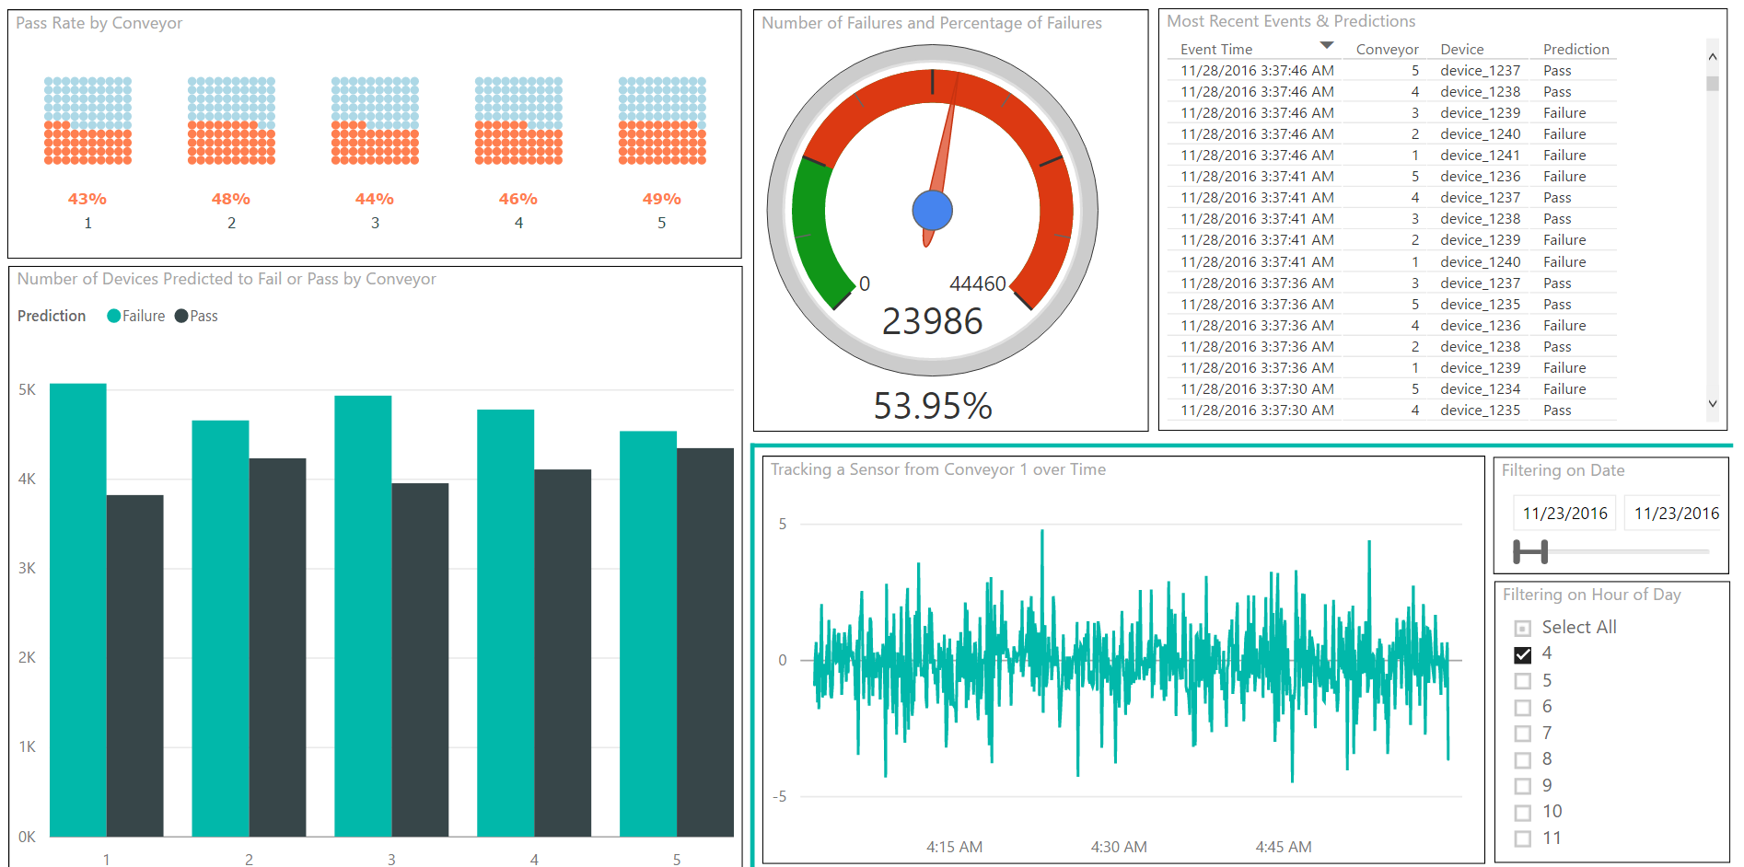
Quality Assurance for Manufacturing | Dashboard Example

Slide 15
Cortana Intelligence Suite

Slide 16
Cortana Intelligence Suite | Overview
Cortana Intelligence is a fully managed big data and advanced analytics suite in the cloud that transforms data into intelligent action.
Cortana Intelligence…
Allows you to collect, manage, process and store all your data that can seamlessly and cost effectively grow over time in a scalable and secure way.
Provides easy and actionable analytics powered by the cloud that allow you to predict, prescribe and automate decision making for the most demanding problems.
Enables intelligent solutions through cognitive services and agents that allow you to see, hear, interpret and understand the world around you in more contextual and natural ways.

Slide 17
Cortana Intelligence Suite | Advantages
COST
SCALABILITY
GROWTH
There are no upfront costs or COGS (Cost of Goods Sold) component costs associated. Meaning there is no need to invest in hardware, software, and/or IT maintenance. This translates into a substantial reduction in business risk.
Servers for computing and/or storage can be deployed and scaled on an as-needed basis and can be done quickly and easily. This effects the cost efficiency advantage of a cloud-based solution with a pay-for-what-is-used policy.
Features, components, and capabilities are consistently being introduced and evolved in Cortana Intelligence Suite. As such, they can easily and quickly be implemented in a cloud-based solution.

Slide 18
Cortana Intelligence Suite | Overview
Information Management
Big Data Stores
Machine Learning and Analytics
Intelligence
Data Sources
People
Data Factory
Data Lake Store
Machine Learning
Cognitive Services
Data Catalog
SQL Data
Warehouse
Data Lake Analytics
Bot Framework
Web
Apps
Event Hubs
HDInsight
Cortana
Mobile
Apps
Stream Analytics
Bots
Dashboards & Visualizations
Sensors and Devices
Power BI
Automated Systems
Data
Intelligence
Action

Slide 19
Appendix

Slide 20
Cortana Intelligence Suite | Benefits
Cortana Intelligence Suite enables you to realize your business outcomes by providing tools to transform data into intelligent action. It transforms entire systems of production, management and governance by enabling you to reap business benefits such as:
Improve visibility and prediction accuracy
Get the right products to the right places efficiently
Offer customers exactly what they want, when they want it
Fix problems proactively before they start
Capture new business opportunities
Use Cortana Intelligence Suite to improve outcomes and solve challenges across all aspects of your business.

Slide 21
Cortana Intelligence Suite | Used in this Solution
Azure Machine Learning
Azure Machine Learning is a cloud predictive analytics service that makes it possible to quickly create and deploy predictive models as analytics solutions. It learns from existing data in order to forecast future behaviors, outcomes, and trends. These forecasts or predictions from machine learning can make apps and devices smarter. You can work from a ready-to-use library of algorithms, use them to create models on an internet-connected PC, and deploy your predictive solution quickly. Start from ready-to-use examples and solutions in the Cortana Intelligence Gallery.
Azure Machine Learning not only provides tools to model predictive analytics, but also provides a fully managed service you can use to deploy your predictive models as ready-to-consume web services.

